Slide 1
buy.gsa.gov – a smart place to do market research Andrea Azarcon Heller
Notes:
Introduce myself.
Describe what the class is and how it's relevant to the audience.
Talk about my contracting and acquisition experience.

Slide 2
Agenda
What is buy.gsa.gov?
Case Study
Q&A

Slide 3
What is buy.gsa.gov?
This website is designed to make it easier for
Government agency customers to navigate the complete acquisition process
Industry to bring needed supplies and services into the federal marketplace

Slide 4
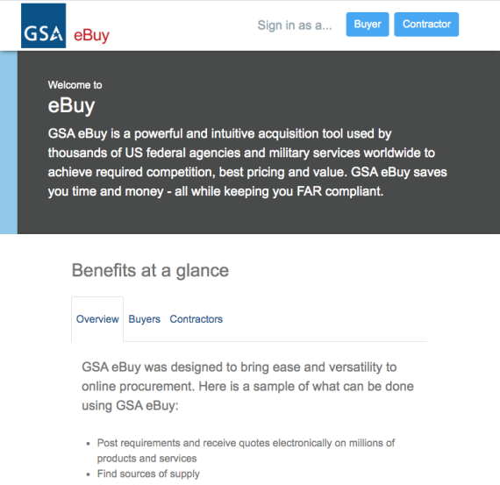
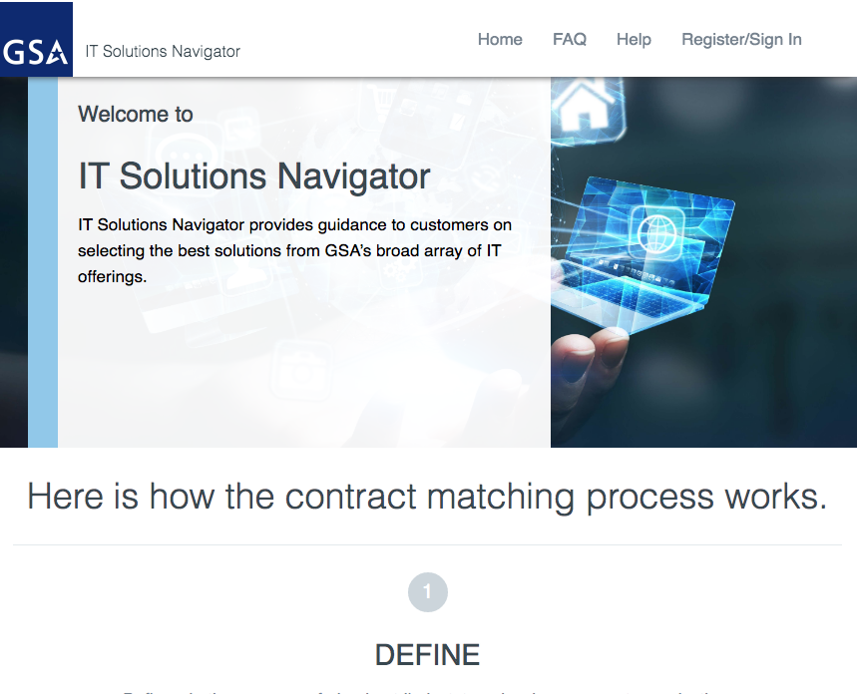
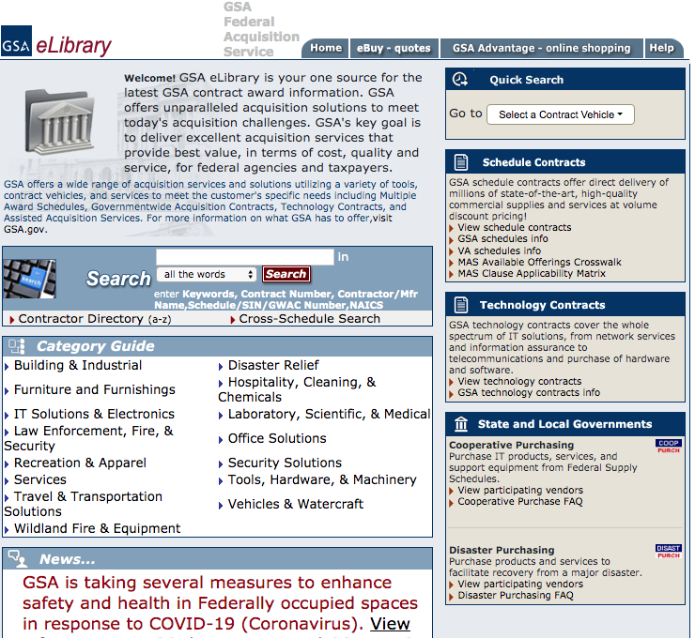
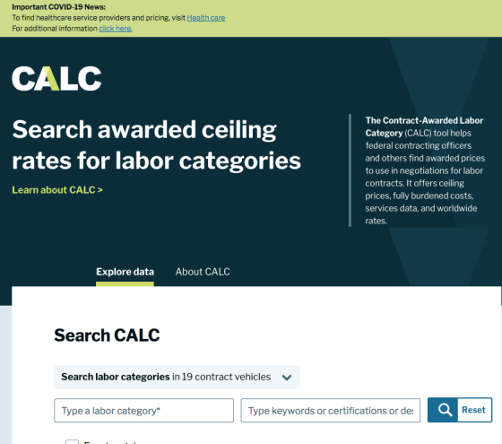
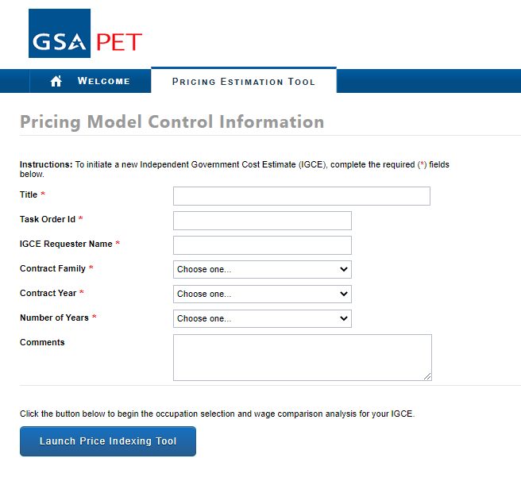
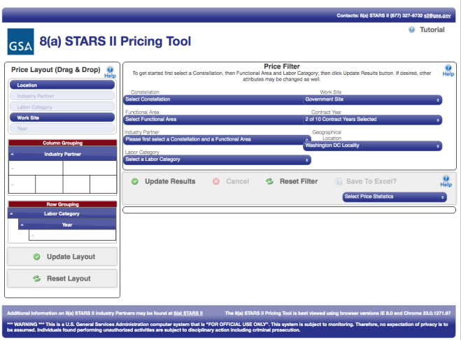
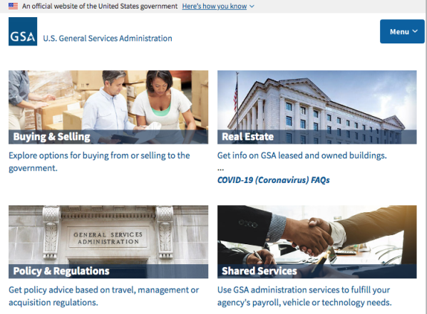
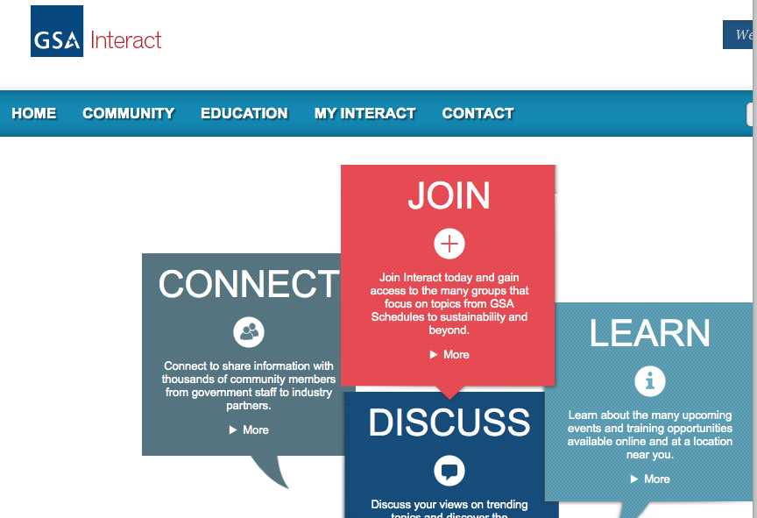
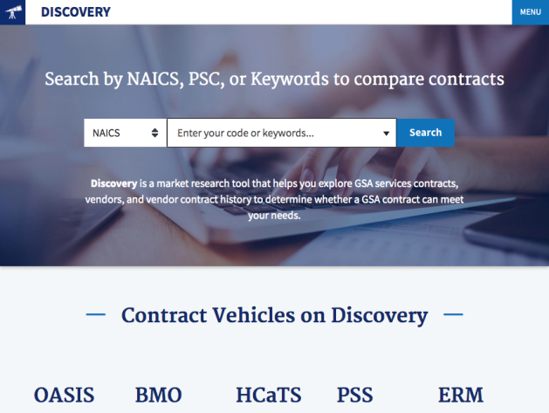
GSA Systems – Current State
Front End:
Different sites with varying functionality & purpose
Different look and feel between sites
Back End:
Lack of interoperability and data sharing between systems Disparate system management & data sources

Slide 5
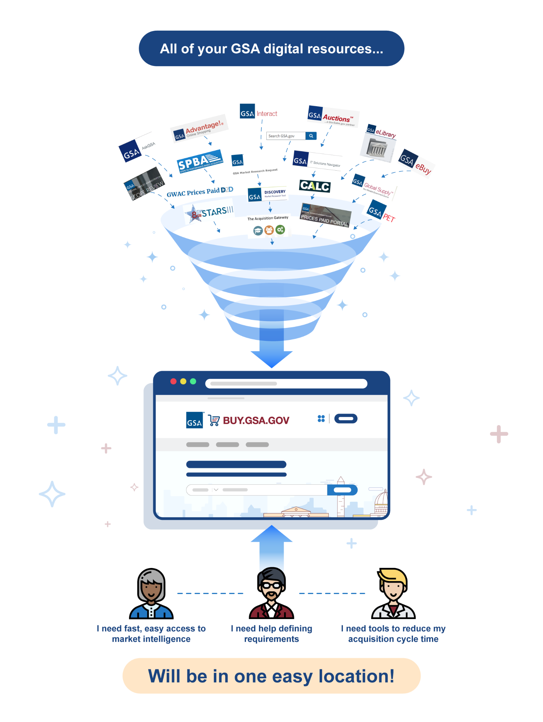
buy.gsa.gov Vision
“Provide a consistently great digital experience connecting agency customers to GSA suppliers intuitively and efficiently in order to fulfill agency missions.”
How?
“Create a self-service application that converges all of GSA’s best market research tools into one system.”
Single Sign On (SSO)
Intuitive Design (HCD Focus)
Consistent Look & Feel
Seamless Interoperability
Automated Data Feeds
Buy.gsa.gov Has:

Slide 6
















Your Feedback Drives Our Development
Research:
In 2019-2021, we conducted 65+ user research & usability testing sessions with more than 15 agencies.
Customer interview focus
Look, feel, and navigation
Desired search functionality
Current tools and processes
Documents needed for an acquisition package

Slide 7
FY22 Usability by the Numbers
Conducted
55
45 min 1:1 customer usability sessions
Across
9
Campaigns (focus areas)
With
17
different agencies
Leading to
220
backlog entries
Resulting in
97
improvements in FY22

Slide 8
Your Feedback Drives Our Development
Pain Points
Solution
Need a way to save and share documents with colleagues and team members
(New) Project Center allows customers to up/download, save, share, and organize documents for their project(s)
1
1
No quick and easy access to templates and sample document(s) for my requirement(s)
(New) Easily find templates, samples, and tips documents for your acquisition planning
2
2
Hate having to remember passwords for various GSA systems
(New) Single-Sign-On functionality for all systems within the site’s ecosystem
3
3
Use Plain Language
Minimized use of acronyms or technical jargon
4
4

Slide 9
Case Study
Let’s buy a mobile office (what in the world is that?!)
Find vendors
Contracts and Vendors
Market Research as a Service/Scope Review
Find sample bill of materials (BOM) or statement of work (SOW)
Estimate how much a Project Manager might be
Notes:
Explain what a mobile office is.

Slide 10
Question and Answer

Slide 11

GSA Starmark Logo

Slide 12
Backup Slides

Slide 13
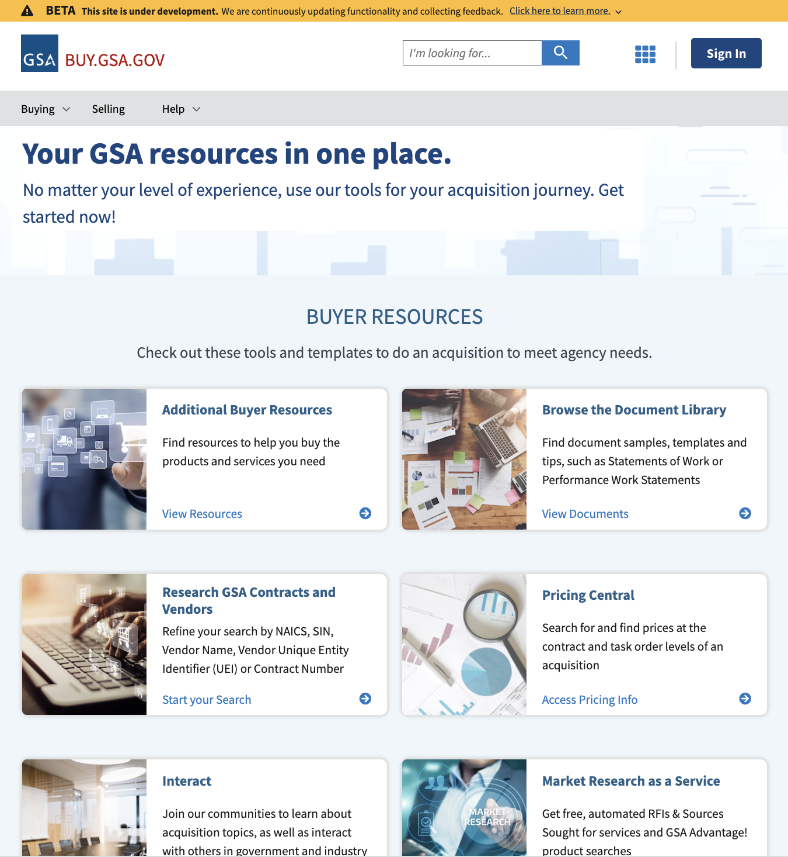
Use your FAS ID (Advantage, eBuy) or MAX.gov account to login for certain resources

Slide 14
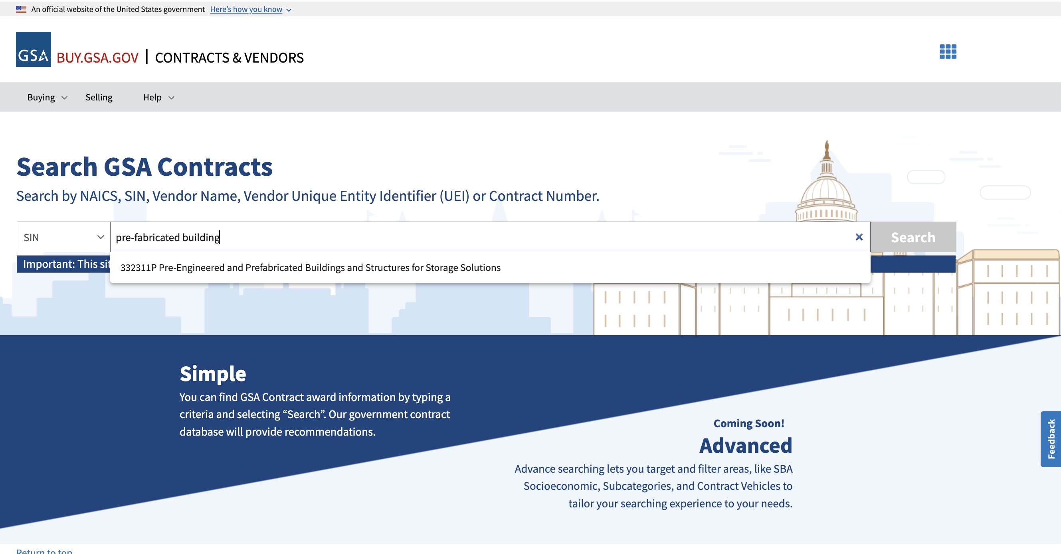
Research GSA contracts and vendors

Slide 15
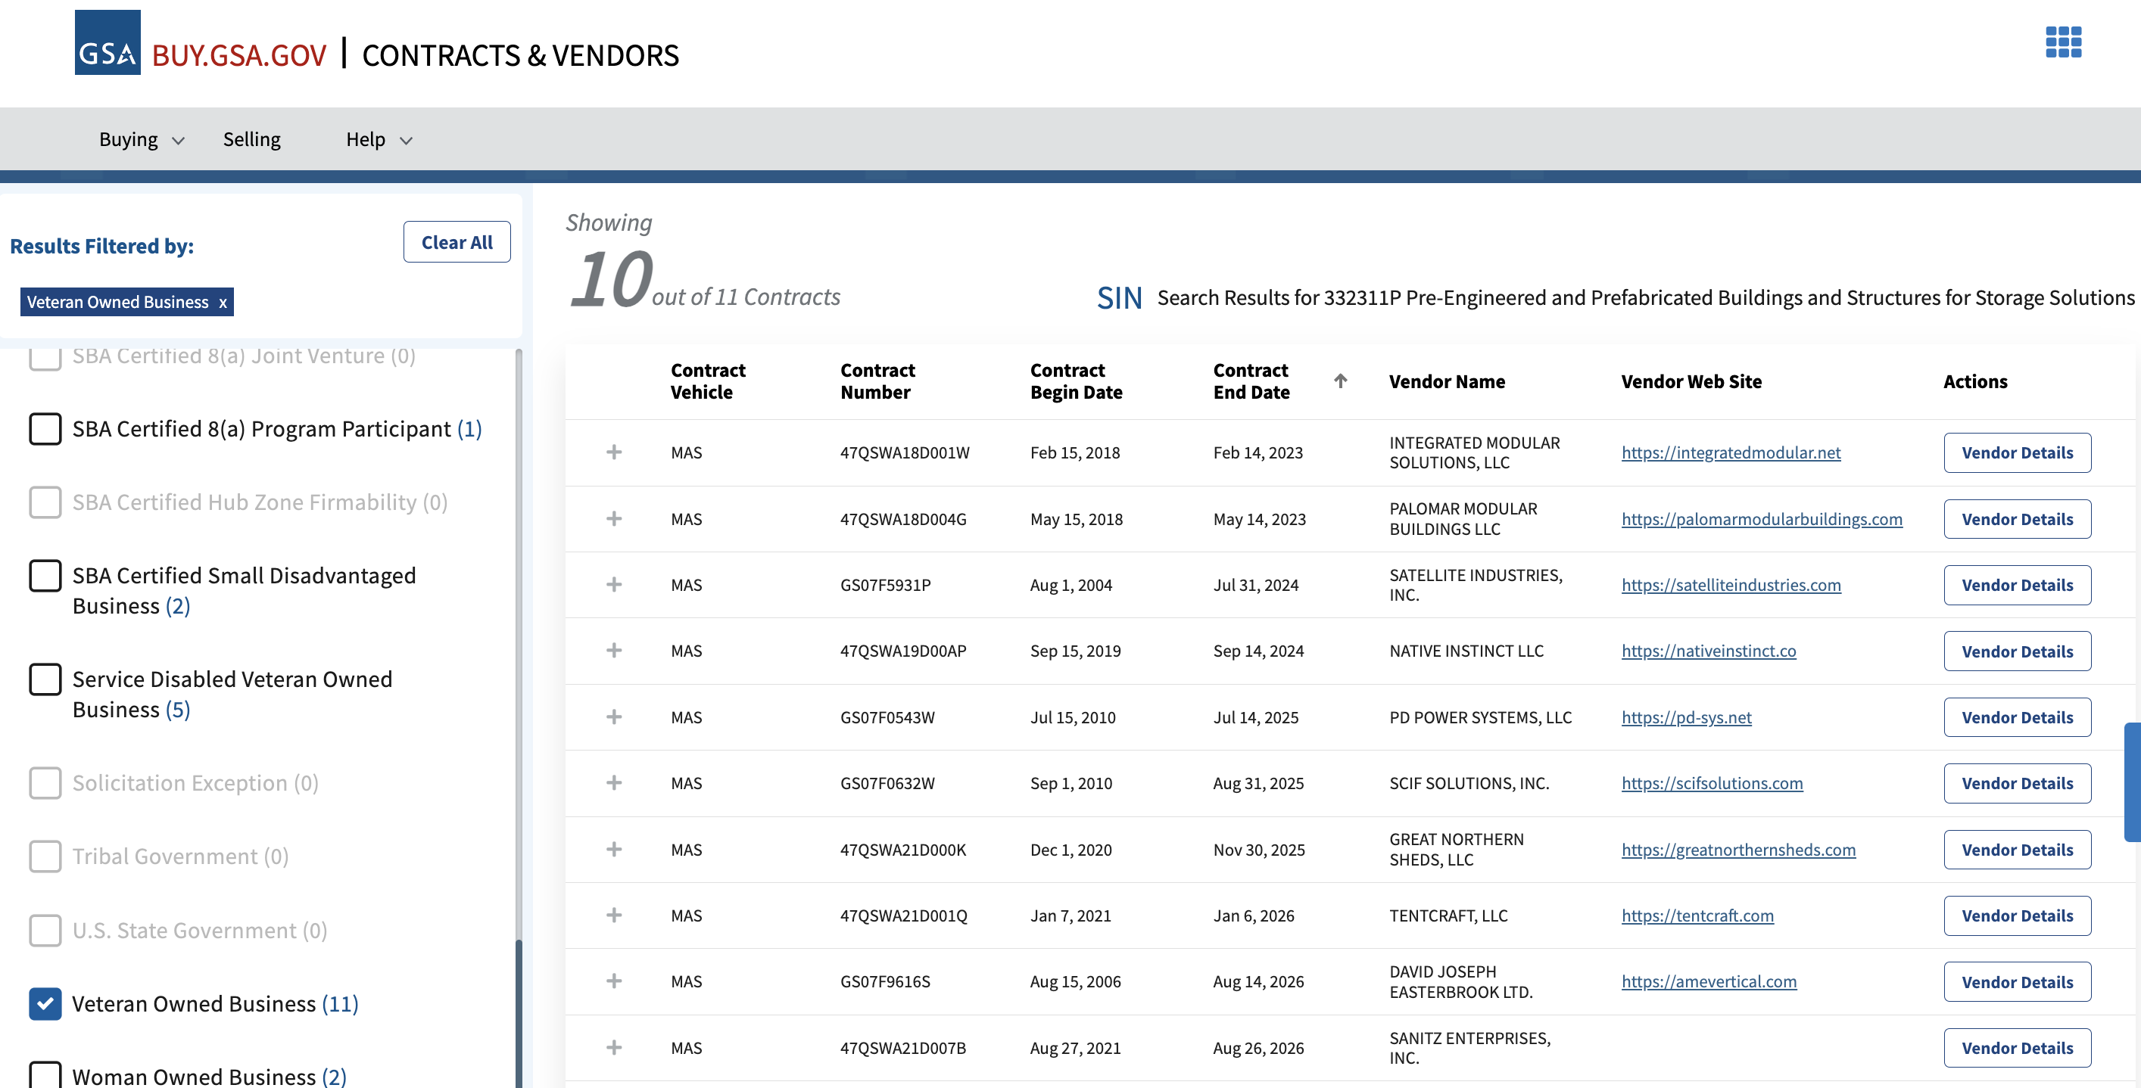
Filter Results (such as socioeconomic)

Slide 16
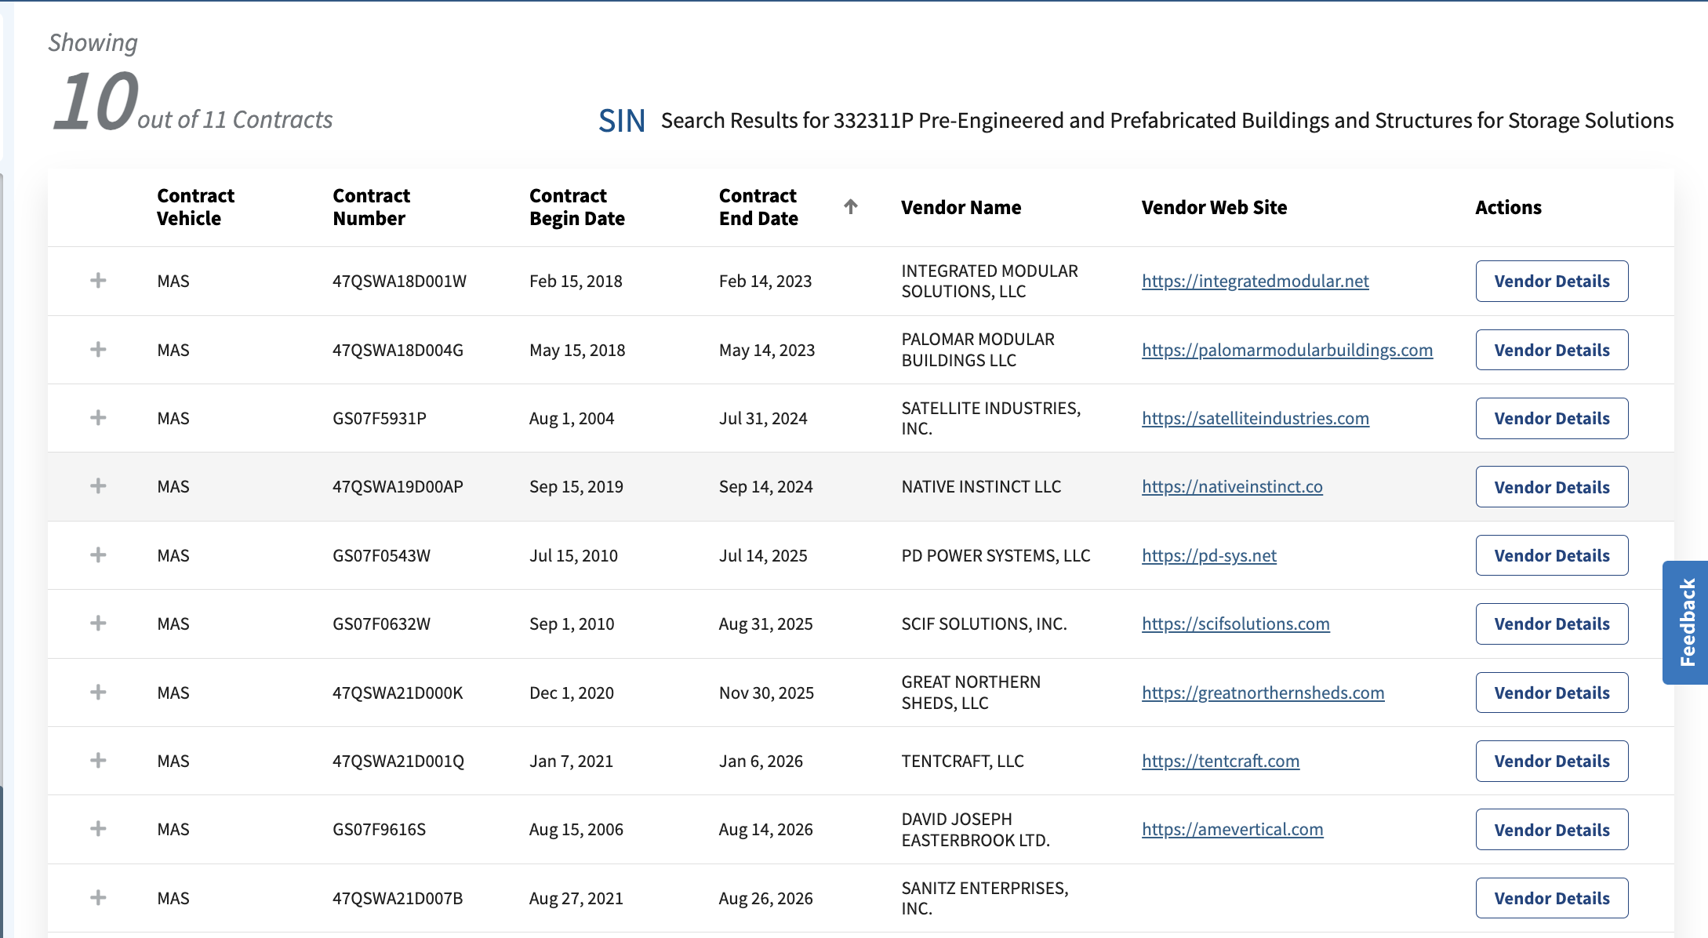
Contract/Vendor Search Results

Slide 17
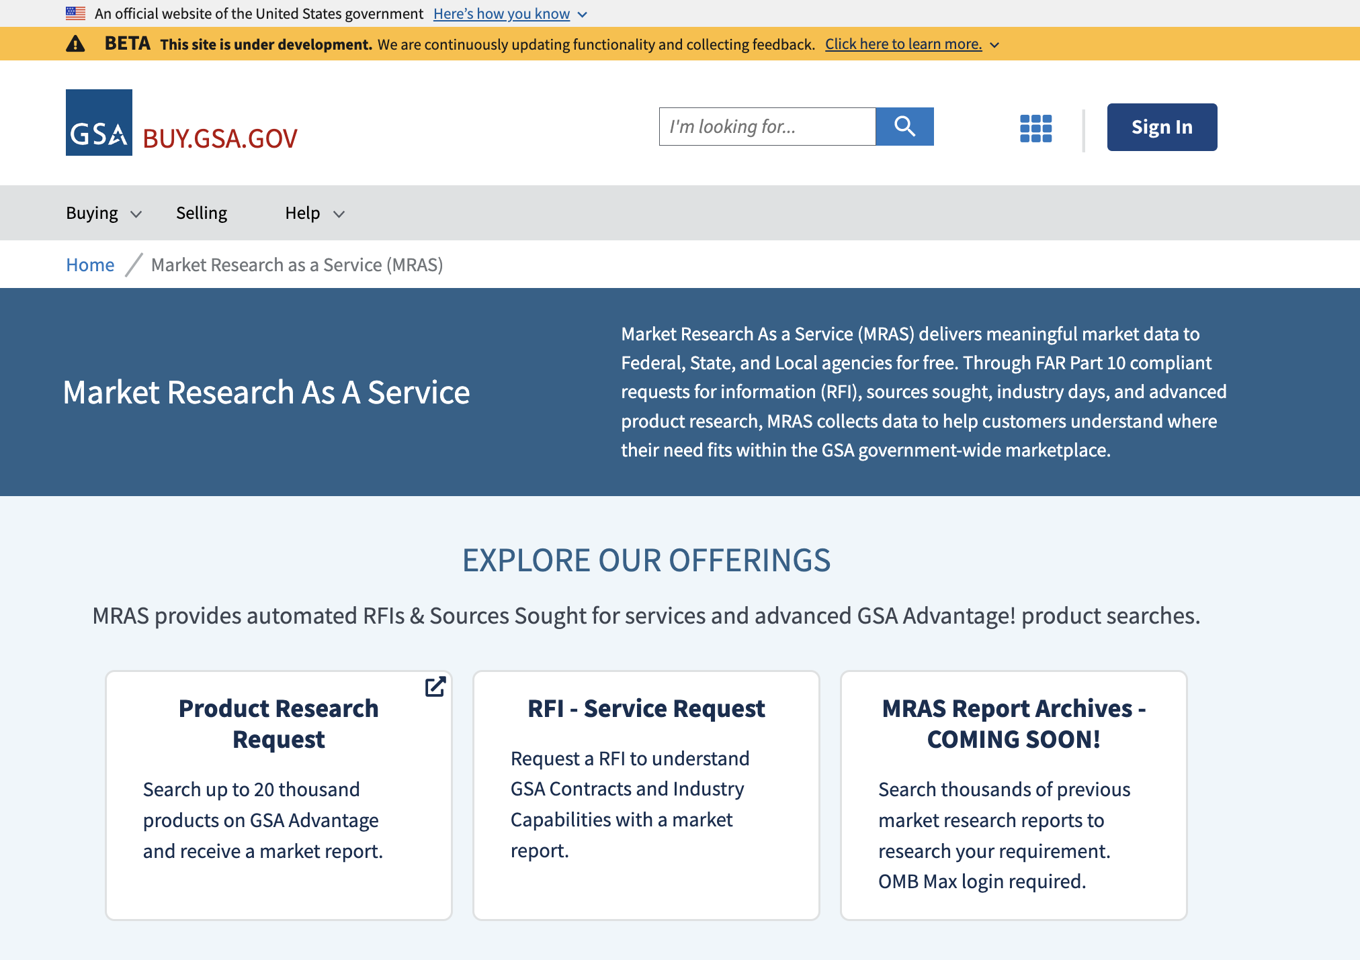
Market Research as a Service

Slide 18
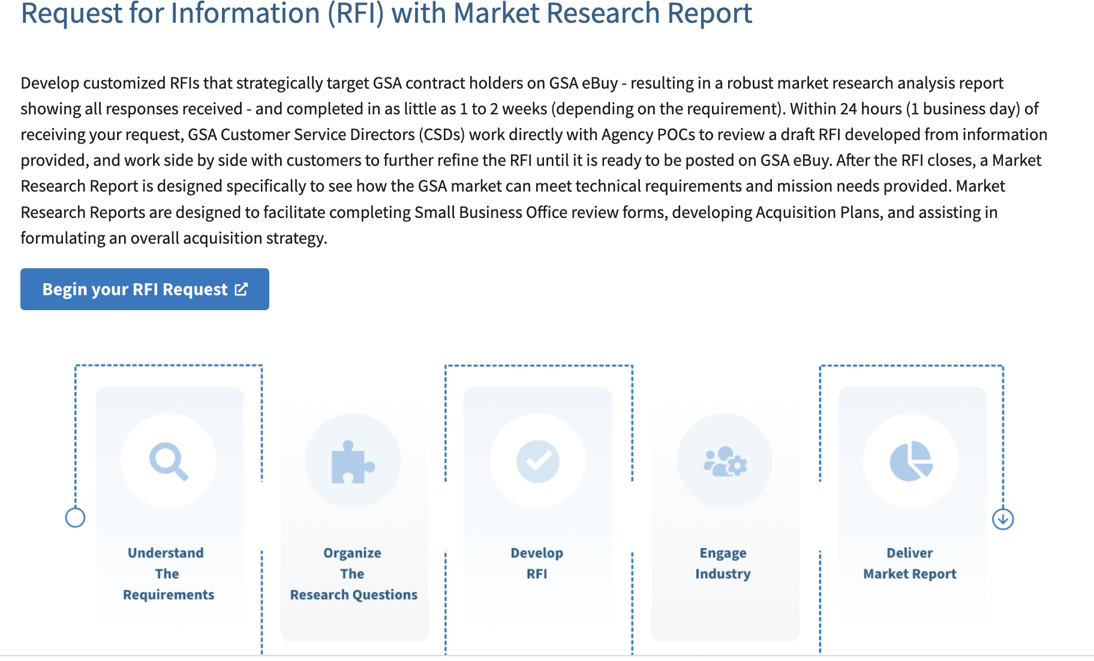
Market Research as a Service

Slide 19
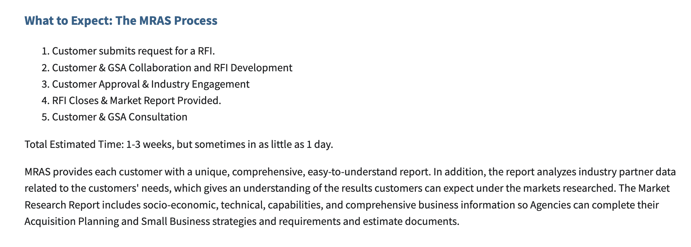
Market Research as a Service

Slide 20
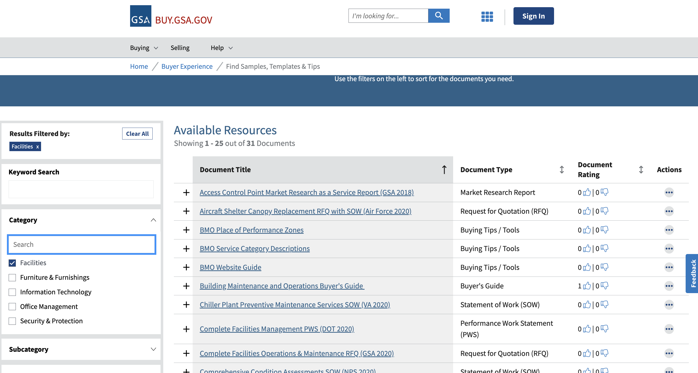
Document Library (Samples and Templates)

Slide 21
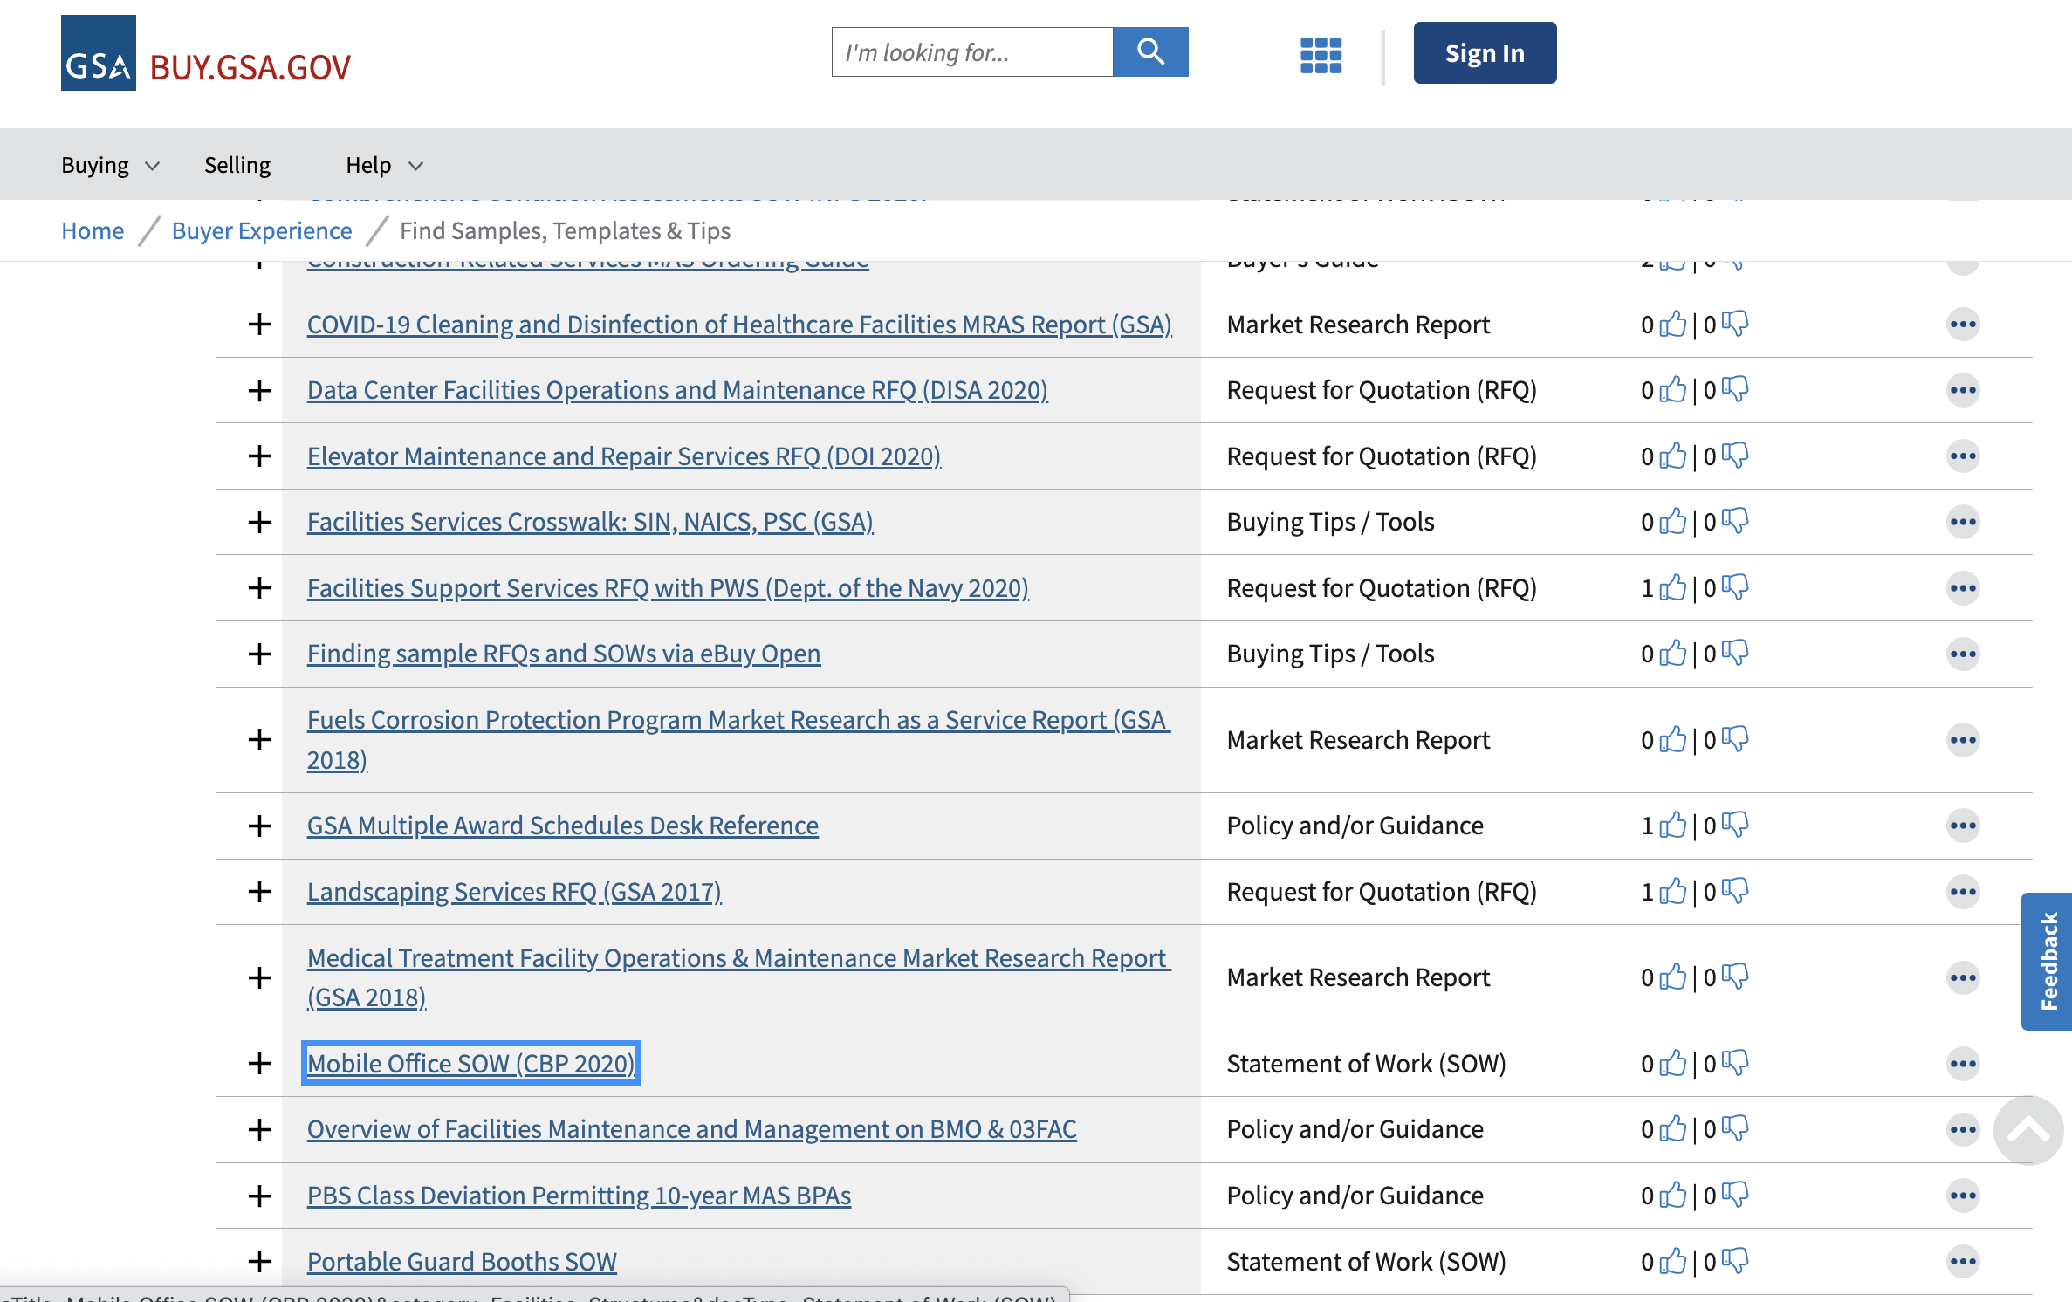
Document Library (Samples and Templates)

Slide 22
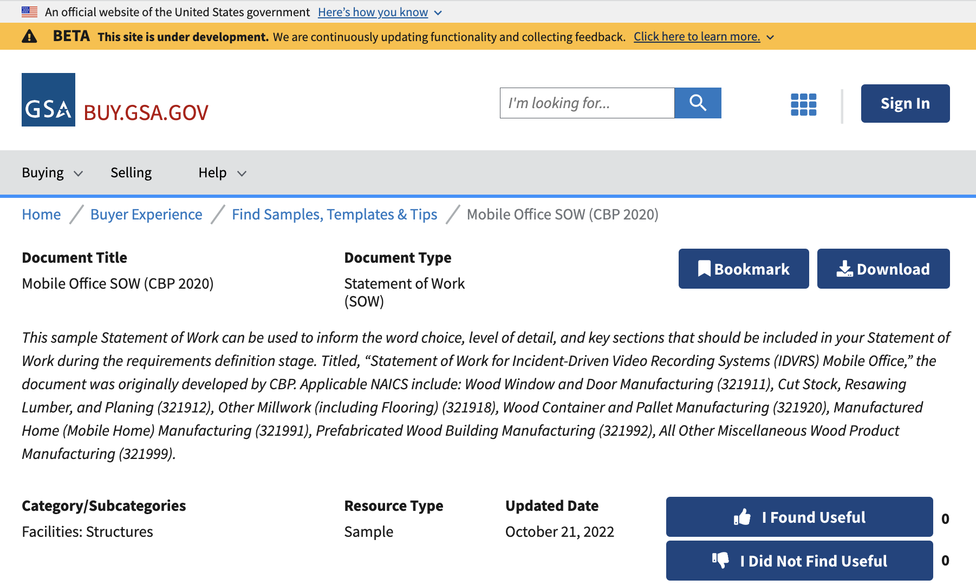
Document Library (Samples and Templates)

Slide 23
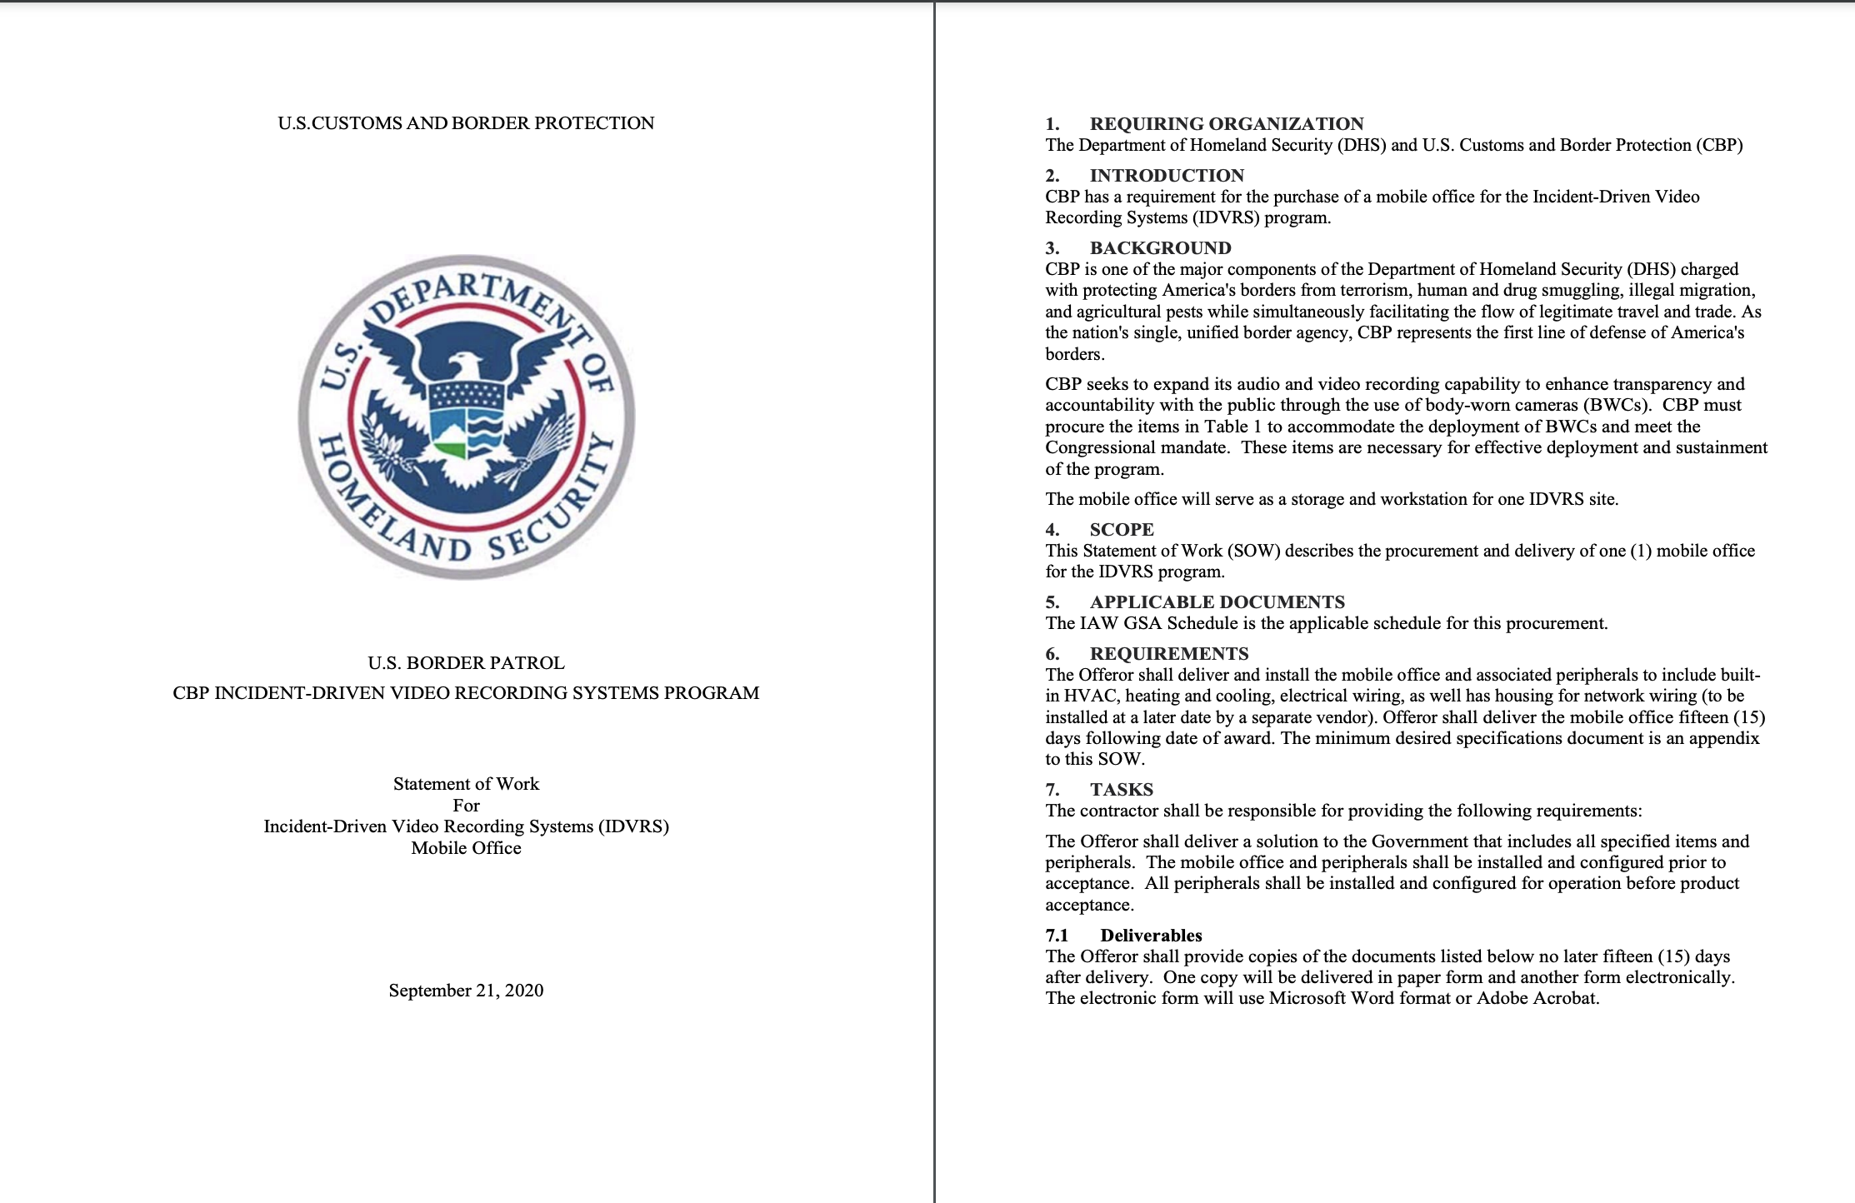
Document Library (Samples and Templates)

Slide 24
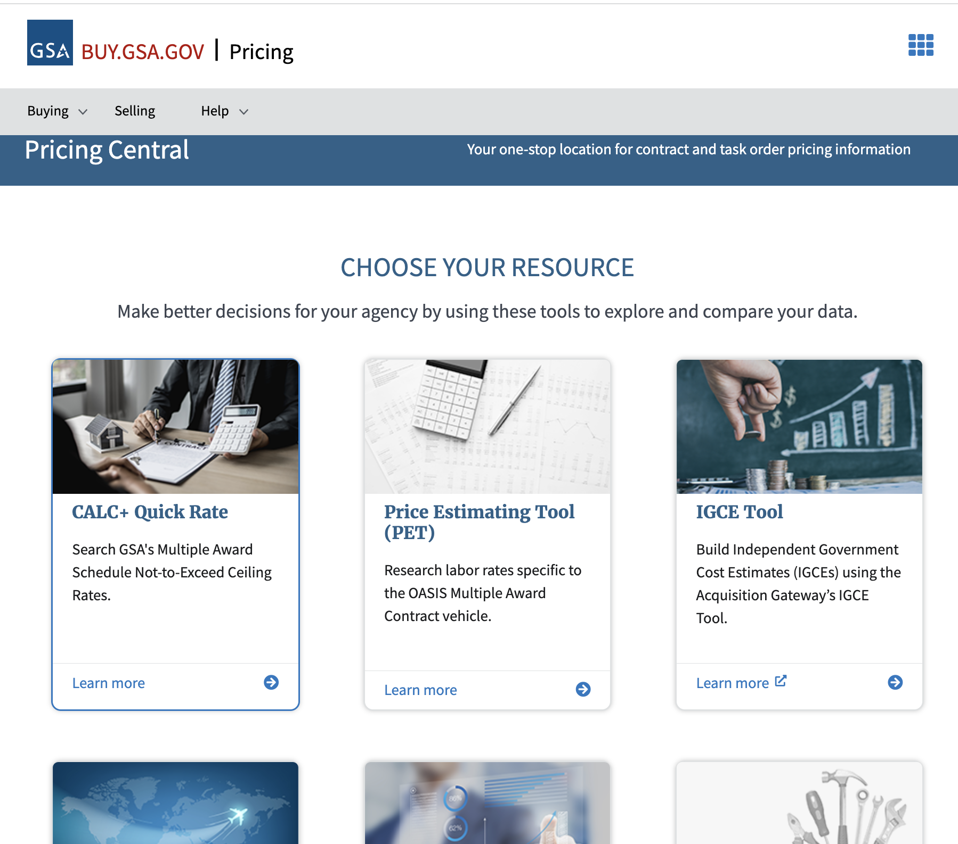
Pricing Central

Slide 25
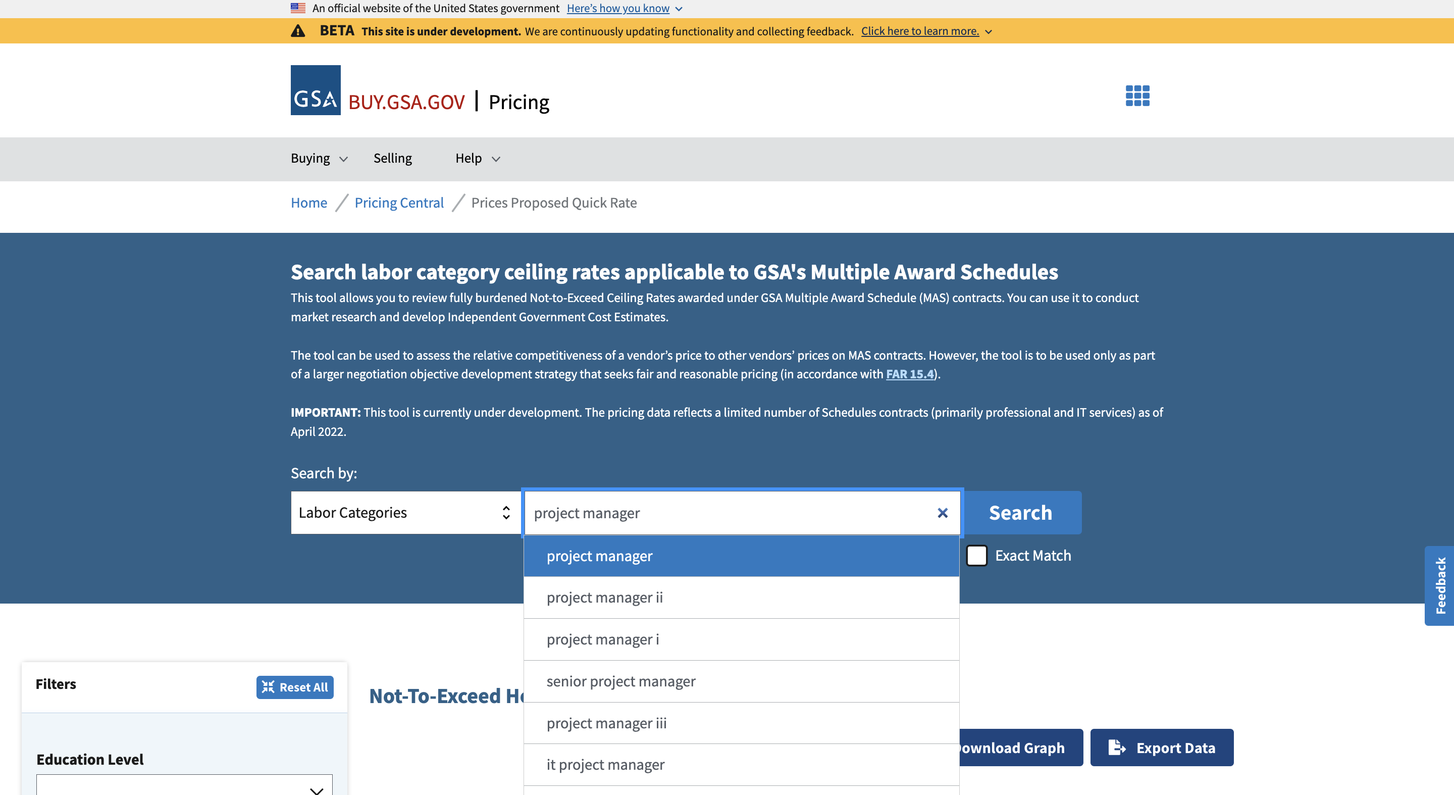
Pricing Central: CALC+ Quick Rate

Slide 26
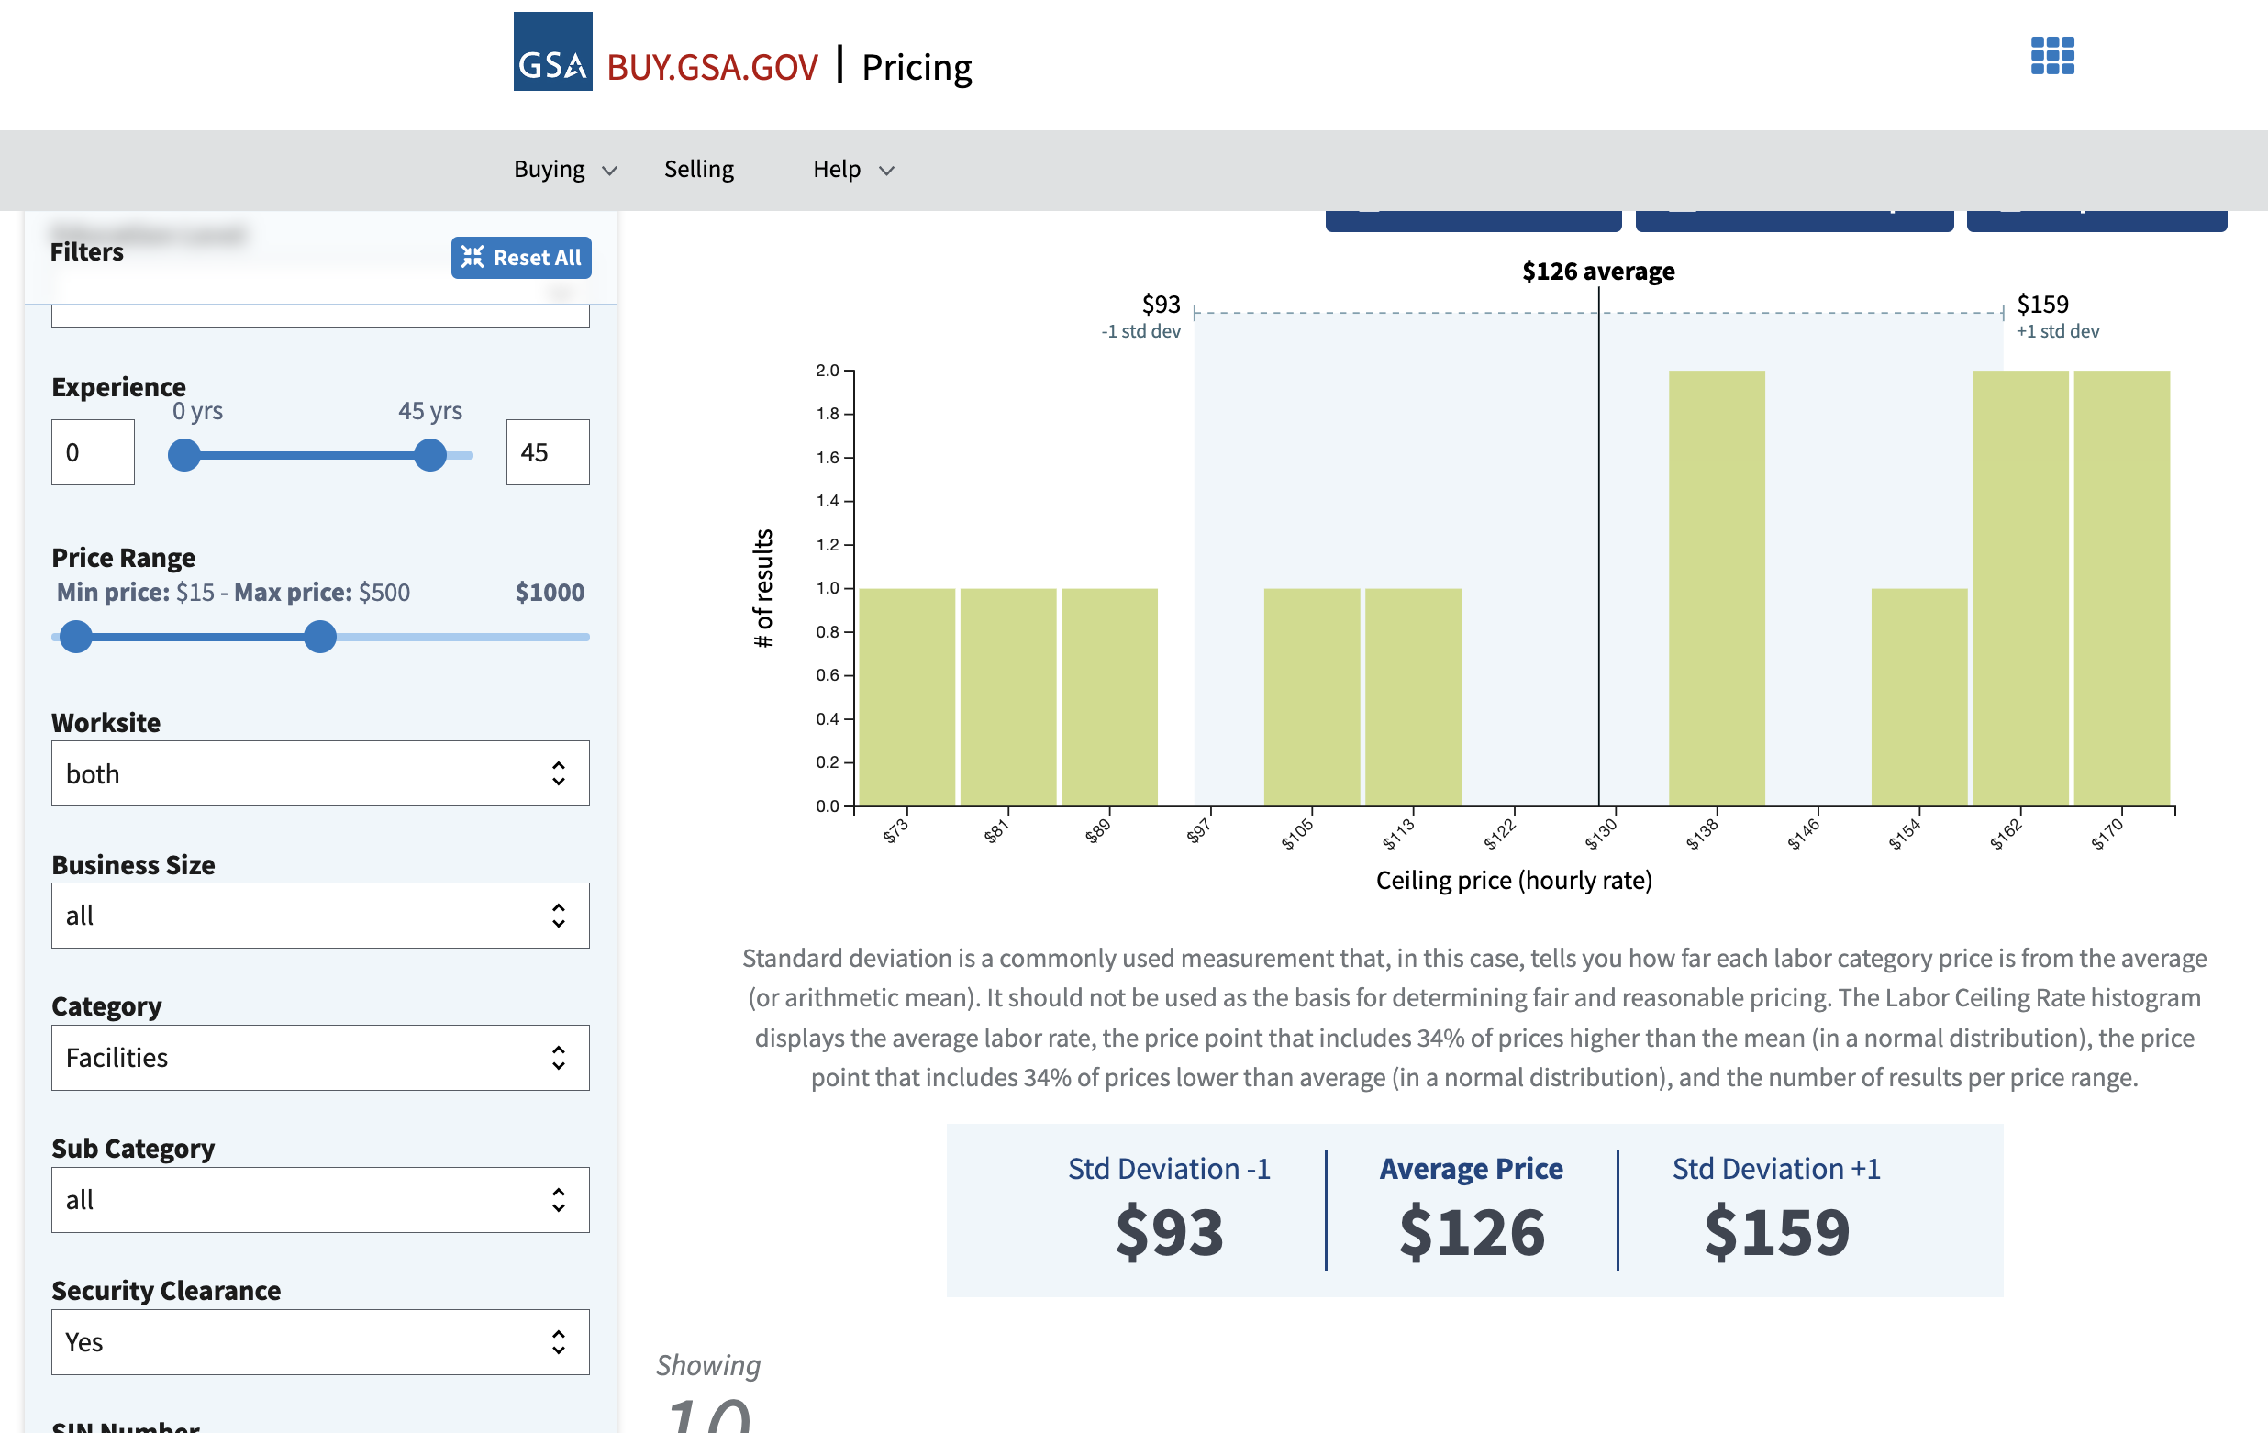
Pricing Central: CALC+ Quick Rate

Slide 27
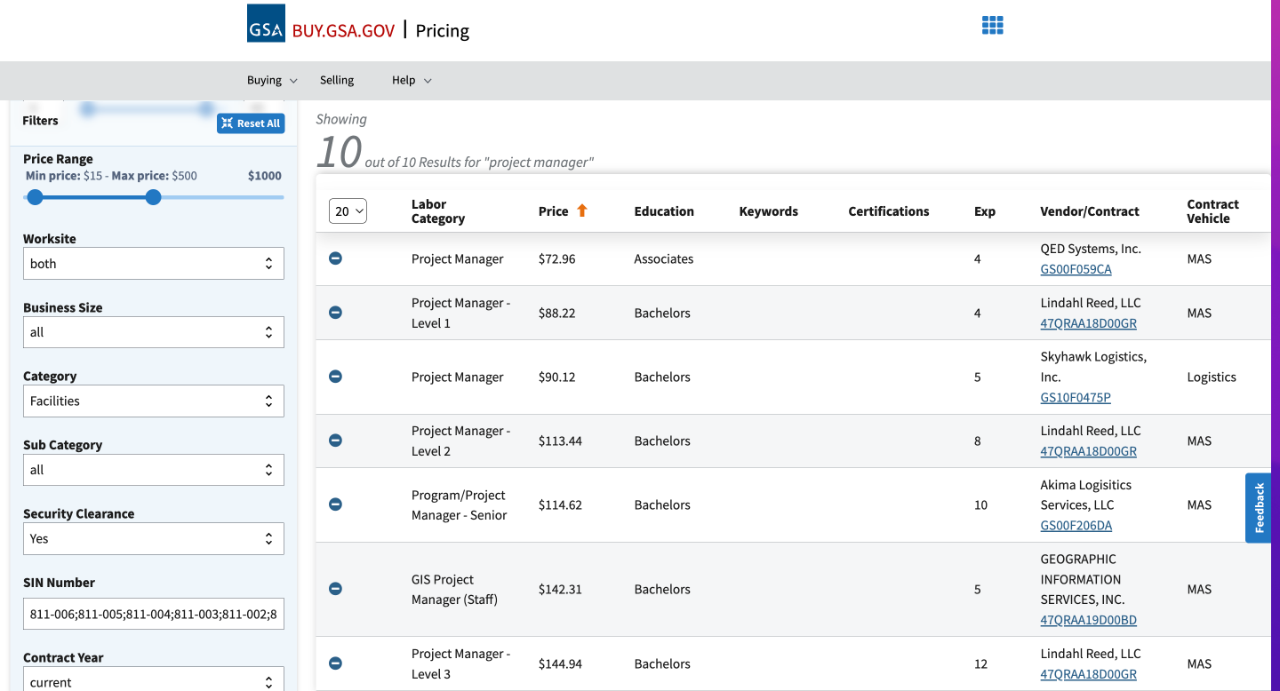
Pricing Central: CALC+ Quick Rate

Slide 28

GSA Starmark Logo

